Slide 1
University Spend Analysis and Dashboards using three different BI Applications
October 2019
Team Members:
Adeola Enegbeyi, Sonali Fulzele, Rajinder Gill, Julia Nalyvaiko, Maggie Obryk

Slide 2
Project Overview
The idea for the project came from one of the BIG10 Universities which is looking into purchasing a more sophisticated BI platform
The University is currently using Tableau as their go to BI tool, but is open to other options
The Team decided to utilize the knowledge learned during a 6 month program in order to research & explore at least 3 different BI tools
Two of the BI tools are leaders in the BI market
The other BI application is not so popular
Data Science BootCamp (C) 2019. All Rights Reserved.

Slide 3
Tools Used
Excel Macros
JavaScript
Jupyter Notebook (*20K rows limit)
Pandas
Python
Postgres
Tableau, Power BI, Dundas BI
Data Science BootCamp (C) 2019. All Rights Reserved.

Slide 4
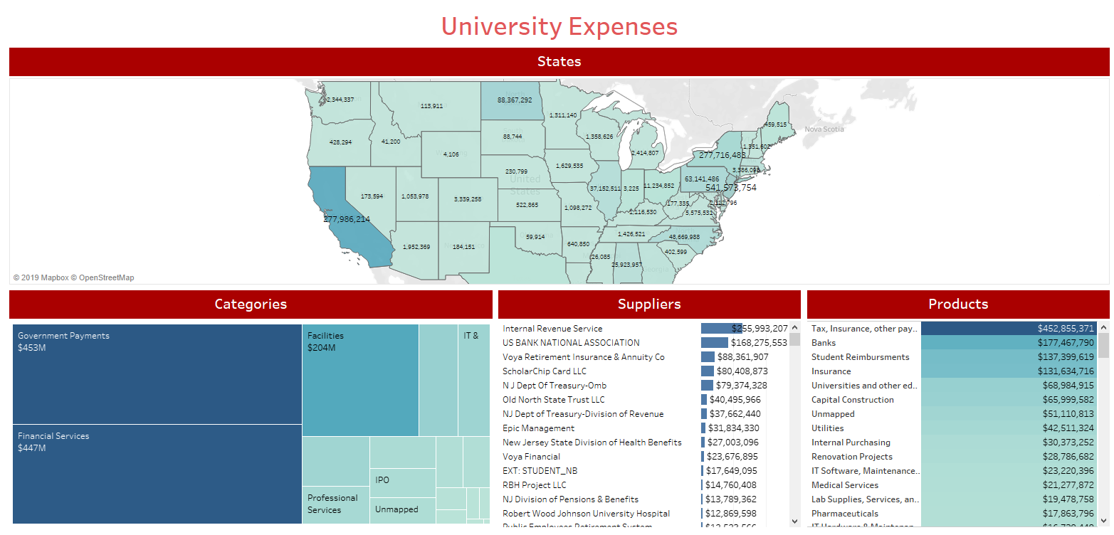
Tableau Demo
Dashboard
Data Science BootCamp (C) 2019. All Rights Reserved.

Slide 5
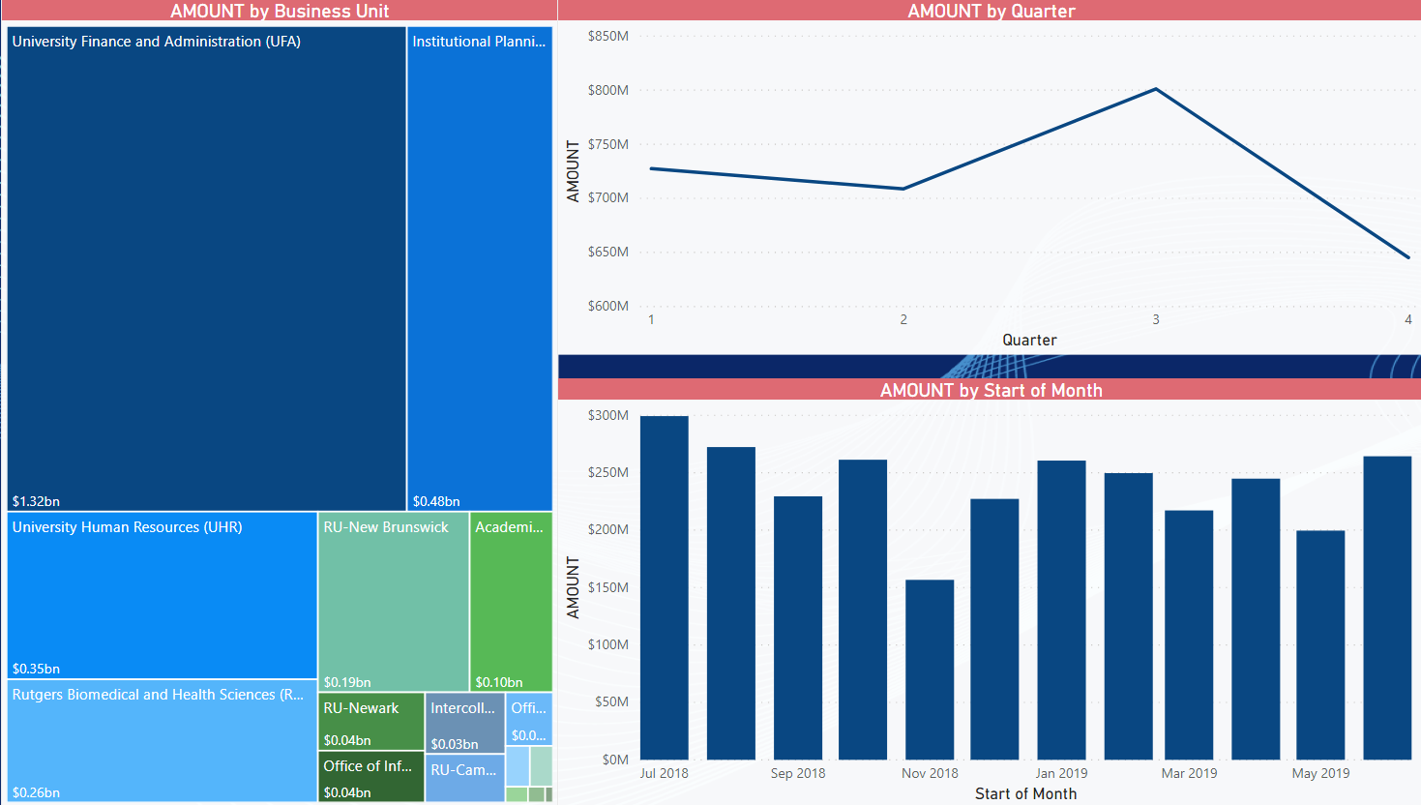
Power BI Demo
Dashboard
Data Science BootCamp (C) 2019. All Rights Reserved.

Slide 6
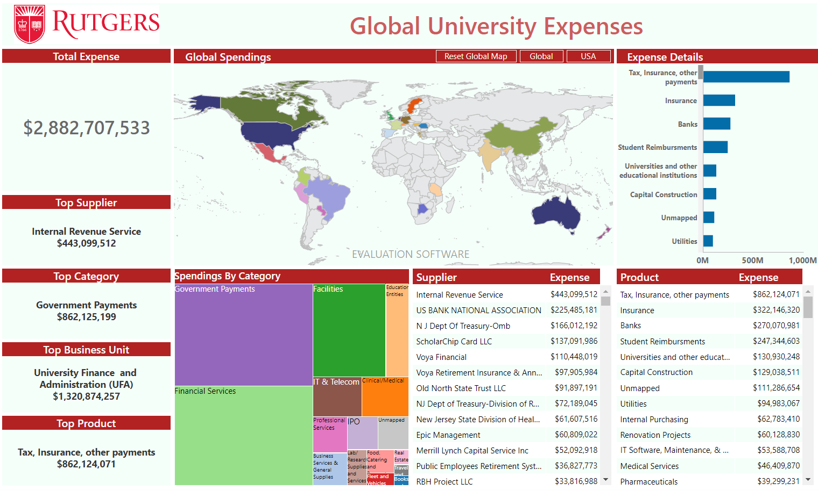
Dundas BI Demo
Dashboard
Data Science BootCamp (C) 2019. All Rights Reserved.

Slide 7
Survey
Which of the three visualizations do you prefer best?
Dundas BI; Power BI; Tableau

Slide 8
Research: BI Applications Pros and Cons
Dundas BI
Microsoft Power BI
Tableau
PROS | CONS
Easy Implementation | Need programing knowledge
Completely web based | Need technical knowledge to connect to data source
Easy to Use | Cost not provided ($?)
Interactive visualizations
Endless Customization
Connects to any Data Sources
PROS | CONS
Easy & Inexpensive Implementation | Bulky User Interface (Sidebar blocks views)
Easy to Use (basically Excel) | Limited Visuals Config
Easy to Save Data in Excel | Inability to work with huge files (2GB limit)
Easy to Upgrade (weekly updates) | Changes done weekly might be hard to keep up
Interactive/Custom visualizations | Real time connections to DB can be a hassle
Connects to multiple Data Sources
PROS | CONS
Easy Implementation | No Custom Visuals
Easy to Use | No Scheduling Features for data refresh
Easy to Upgrade | Limited Custom Formatting
Interactive visualizations | Static and single value parameters
Excellent Mobile Support | Limited screen resolution (mobile)
Connects to limited Data Sources | Cost not provided ($?)
Notes:
https://www.capterra.com/business-intelligence-software/compare/155288-176586-77260/Dundas-BI-vs-Power-BI-vs-Tableau

Slide 9
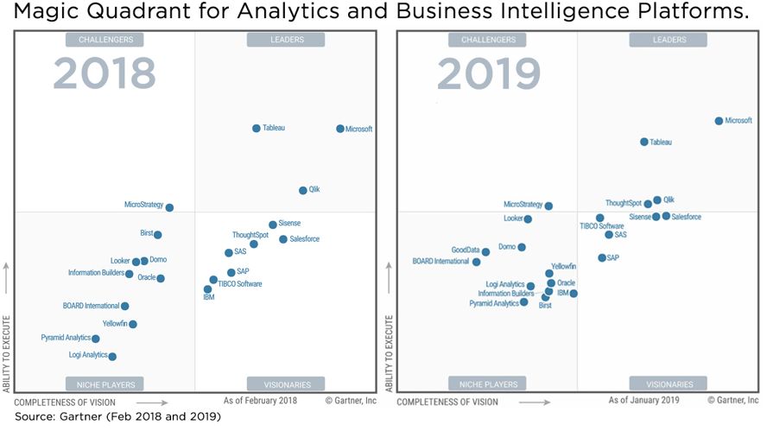
Source: Gartner’s Report; “Analytics and BI Platforms’ Leaders”

Slide 10
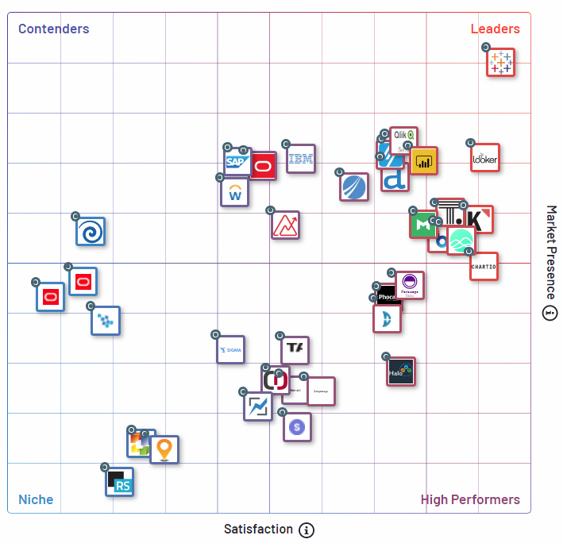
Source: Google (https://learn.g2.com/google-buys-looker-salesforce-buys-tableau)

Slide 11
Survey
Which of the three visualizations do you prefer best?
Dundas BI; Power BI; Tableau

Slide 12
Conclusion
Based on our hands-on experience, we concluded that each and every tool that we worked on is capable of delivering the expected results. However, the flexibility of the BI application determines the extent of customization of users’ needs.
We found that Tableau is somewhat limited; not as flexible as both Microsoft Power BI and Dundas BI.
Dundas BI software is a comprehensive BI tool that can be accessed via any browser. It offers customization features for reporting and dashboards. Although, it requires some programing knowledge, it’s flexible and easy to use.
Overall, Power BI is a great tool for doing data analysis. The pros outweigh the cons. Anyone who does pivot tables, charts, and simple formulas in Excel can start using Power BI to quickly turn data into visuals.
Data Science BootCamp (C) 2019. All Rights Reserved.

Slide 13
Challenges
Large Data Files
Jupyter Notebook has 20K rows limit
Zepl has maximum file size of 20MB
Importing data in Postgres
Converting CSV file format from UTF to ASCII
iconv -c -f utf-8 -t ascii input_file.csv -o output_file.csv
What helped?
Data Science BootCamp (C) 2019. All Rights Reserved.

Slide 14
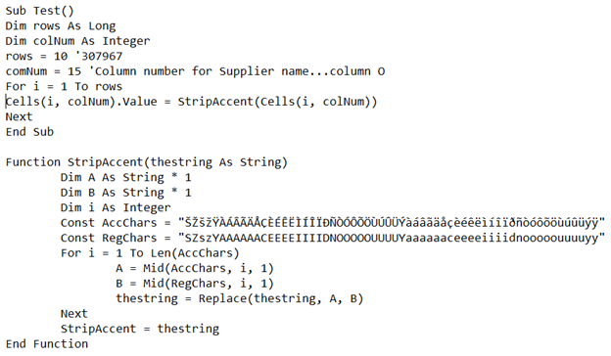
Macro
Data Science BootCamp (C) 2019. All Rights Reserved.

Slide 15
Q&A
Thank You

